Slide 1

Crimes in Philadelphia
Raj Patel, Hong Son, Kunal Sharma

Slide 2



Goals
Identify overarching themes related to crime in Philadelphia through EDA
Equip law enforcement with intelligence to effectively combat crime proactively
Answer our ten exploratory questions effectively
Learn new approaches to EDA
Potentially create a model to predict the likelihood of a crime on Philadelphia predicated on the availability of data for certain attributes

Slide 3


Datasets
Philadelphia Crime Data:
Published by OpenPhillyData
Dates from 12-31-05 to 03-22-17 (majority of the dates are from 2006-2016)
Attributes include the district number, sector, dispatch date, dispatch time, location, general code, descriptions of the crime, and the district
There are 14 total columns and ~4400 in this dataset.
Philadelphia Weather Data:
Published by Pennsylvania State Climatologist
Dates from 2007 to 2018
The dataset includes the temperatures in Fahrenheit, the max and min temperature, environment information, wind, and precipitation.
The data was formatted from PDF files and a dataset was formed [~4,000 rows and 15 columns].
Notes:
Hong

Slide 4
Intended Steps | Due Date | Ownership | Status
Finish & Revise Outline Document | 10-04-20 | Team | Done
Find and retrieve all relevant datasets | 10-13-20 | Hong | Done
Process the Data for Analysis | 10-20-20 | Kunal | Done
Data Acquisition and Preprocessing Report | 11-03-20 | Team | In Progress
Explore the data (Data Combining, Statistical Analysis) | 10-20-20 | Team | In Progress
Data Visualizations | 11-17-20 | Kunal + Hong | In Progress
Perform in-depth analysis | 11-21-20 | Raj | Not Started
Communicate Results | 11-22-20 | Raj | Not Started
Exploratory Data Analytics Report Draft | 11-24-20 | Team | Not Started
Final Project Presentation | 12-01-20 | Team | Not Started
Notes:
Hong

Slide 5


Github
Outline
https://github.com/hongson1218/Crime-in-Philadelphia
https://docs.google.com/document/d/1cxNI0w_d4mack9Nd_YizriTSXW0dSyXjg7pHAod--ss/edit?usp=sharing
Notes:
Hong

Slide 6
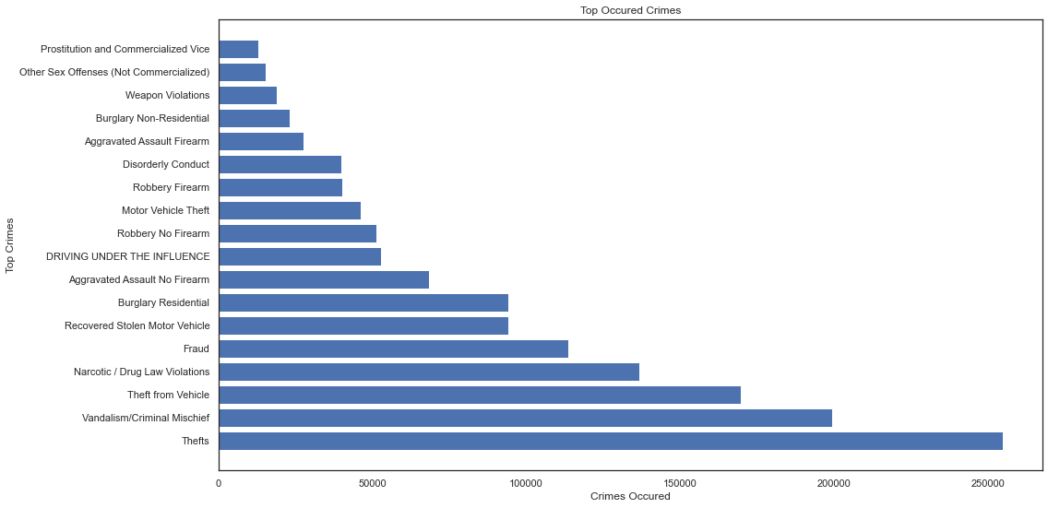
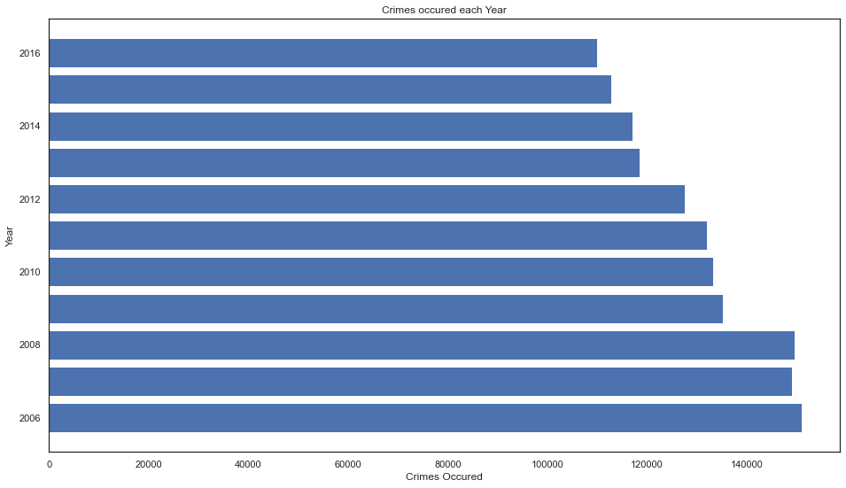
Done So far
Combined Weather Data to the analysis
Answered the following Questions
What are the top crimes over the 10 year period ?
Have crimes been increasing over the 10 year period?

Slide 7
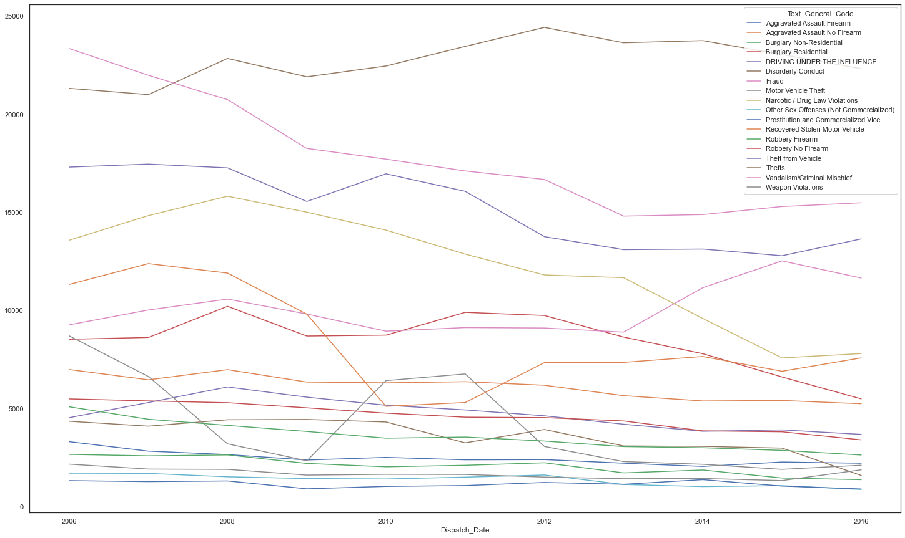
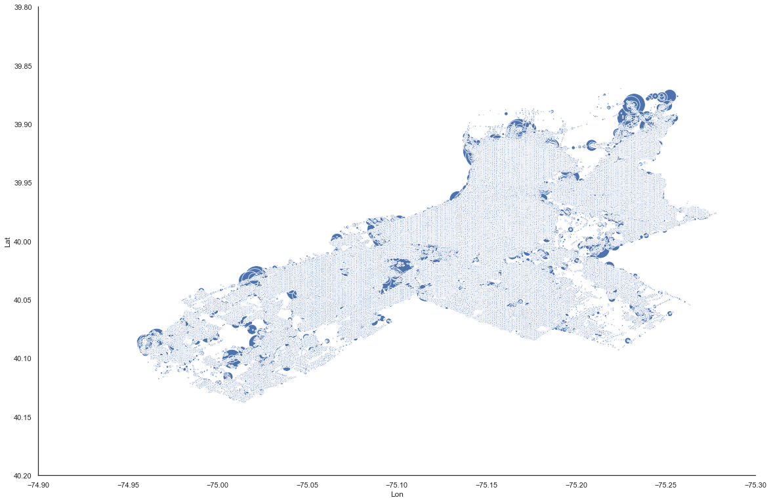
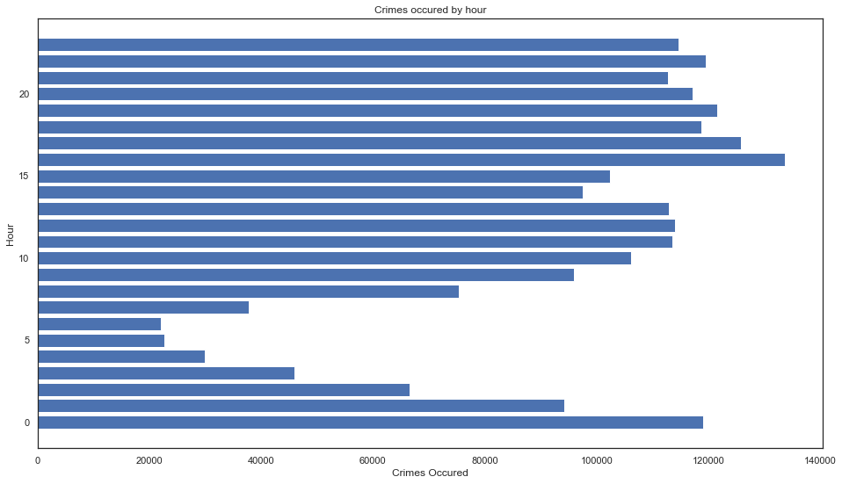
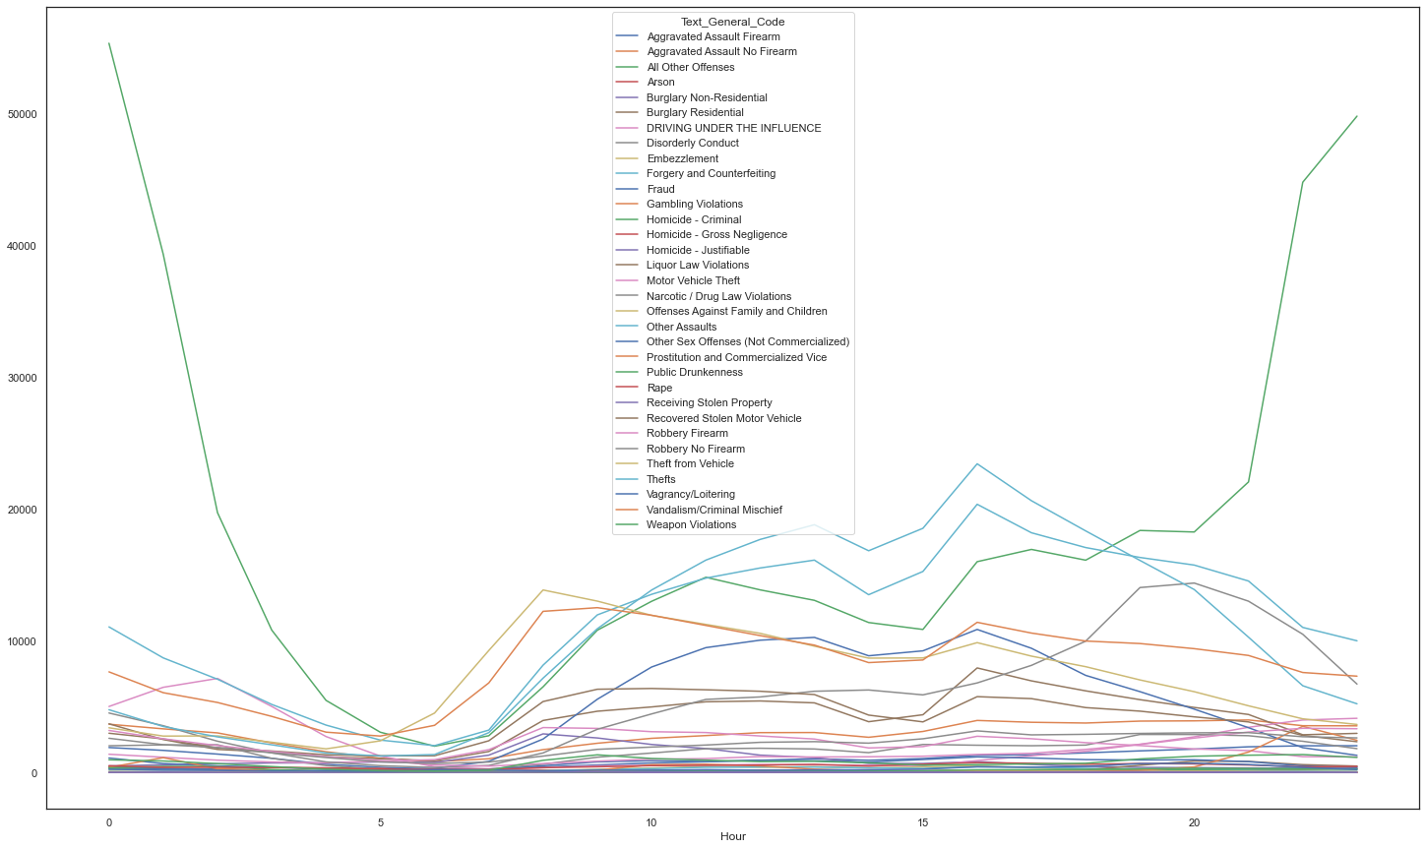
What types of crimes are on the rise? What types of crimes have fallen? (Over 10 year period)
What are the dangerous times (hours) to be outside or for crimes to happen?
What District/Region has the most crimes?
Notes:
Hong

Slide 8
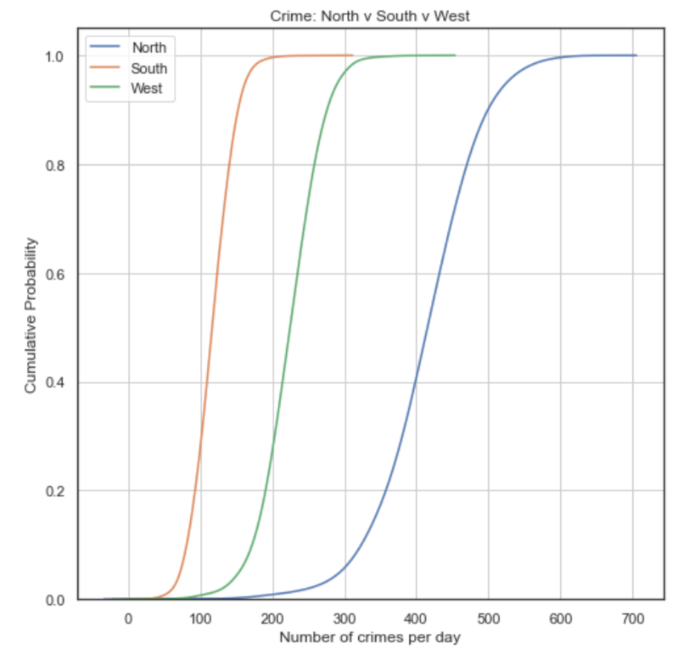
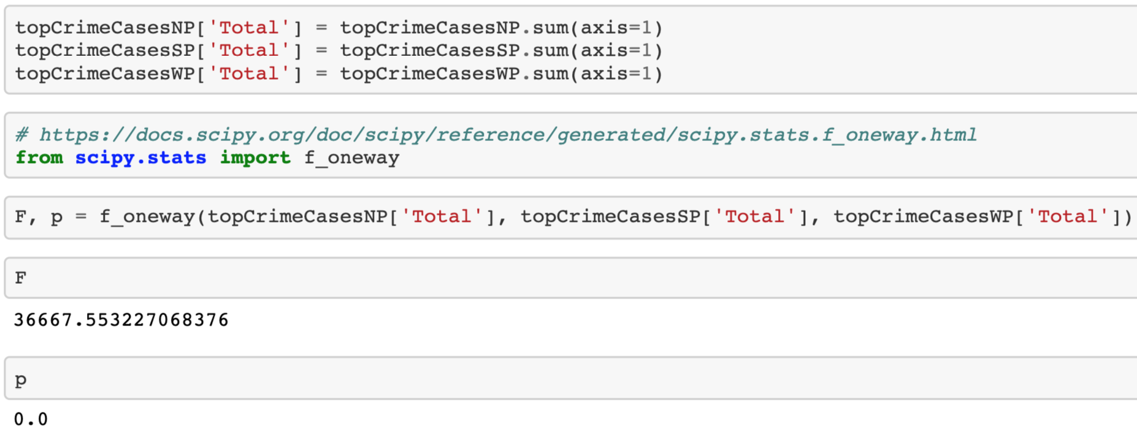
Anova
CDF Plot
H(o): Average crime count is the same across regions (north, west, south)
H(a): Average crime count is not the same across regions (north, west, south)
Alpha value: 0.05
P = 0
Reject null hypothesis
Statistically significant
Average crime counts are not the same across regions

Slide 9
Next Steps
Integrate Weather Data into Analysis
Continue/Review Data Visualization work
Continue/Review Statistical Analysis work
Data Acquisition and Preprocessing Report
Exploratory Data Analytics report draft
Final Project Presentation
Notes:
Hong

